Slide 1
Conduct a Squad Assault
07-4-D9515

Slide 2
Conditions
Squad/Section is moving or temporarily halted
Receives direct fire contact from enemy force

Slide 3
Individual Actions
Return Fire
Seeks cover (fight to get generally on line with element)
Alerts element
  Alert: Contact
  Type of threat (troops, APC, etc)
  Direction (Cardinal is preferred, although clock direction in relation to direction of travel may also be utilized)
  Distance

Slide 4
Leader Actions
Team Leader in contact
  Establish base of fire by giving rates of fire
    Rapid until suppression is achieved
    Sustained thereafter
    Back to rapid any time friendly movement occurs or enemy is attempting to regain fire superiority
  Give left/right limits to each member of subordinate element
    Interlocking 50 meters ahead
  Accurately send reports to next higher IC

Slide 5
Leader Actions
Squad/Section Leader
  Allow team leader in contact to develop situation
  Move up to team leader in contact and assess effects of fire on enemy
  Form COA for element and recommend to next higher IC
    If enemy force is inferior, make decision to assault enemy
    If enemy force is superior, make decision to break contact or maintain contact for follow on force to assault enemy
  If assaulting enemy:
    Designate TRPs, sectors of fire, and fire control measures (shift/lift fire points)
    Fire control measures should be easily identifiable from base of fire position and planned LCC for assaulters
    Determine covered/concealed route to flank and assault enemy position
  At this point control of the gun is usually handed over to team leader in contact

Slide 6
Leader Actions
Team Leader not in contact
  Establish security
  BPT maneuver to form base of fire to support break contact
  BPT maneuver to flank/assault

Slide 7
Leader Actions (Flank)
Element Leader
  Moves to team not in contact, gives hand and arm signal for a file
  Leads assaulters along covered and concealed route to LCC at flank of enemy
  Positions assaulters in line along LCC and shows fire control measures to team leader
Team Leader in Contact
  Establishes a rapid rate of fire to cover movement of assaulters
Assault Team Leader
  Follows Squad/Section Leader in a file
  Acknowledges and confirms fire control measures, disseminates to team

Slide 8
Battle Hand off
Assaulters positioned at LCC, O/O engage enemy with rapid rate of fire for 10 seconds
Base of fire acknowledges by engaging at rapid rate of fire for 10 seconds in return, then shifts fire
Squad/Element leader calls “shift fire”
Base of fire leader confirms his men are shifted and replies with “shift fire bingo”
Assault TL confirms with “Shift fire confirmed” and begins bounding his element to next fire control measure

Slide 9
Leader Actions (Assault)
Squad/Section Leader holds assaulters at each FCM until entire sequence of “shift fire,” “shift fire bingo,” and “shift fire confirmed” is complete.
Base of fire and assault TLs must still be aware of each fire control measure and communication is paramount – anyone can hold element and call “shift fire” if need be
Assault TL must control his element through their bounds, ensuring his men are not “funneling.”

Slide 10
Leader Actions (Assault)
Assault team leader
  Calls “LOA” at 50 meters past the last EKIA
  Immediately goes “hands on” each member of his team, setting left/right limits and collecting a LACE report
  Disperses key weapon systems for best employment (observation/fields of fire)
  Consolidate LACE reports for next higher IC

Slide 11
Leader Actions (Base of Fire)
Base of Fire TL
  Once LOA is called by Assault TL (relayed via FM/PACE if necessary), pick up element and move through objective on line
  Positions Gun at the Apex
  Disperses key weapon systems
  Collects LACE reports

Slide 12
Leader Actions (Consolidate/Reorganize)
Squad Leader
  Positions at apex of “L” shape
  Calls for Special Teams
    EPW/SSE, A&L, Demo
    EPW always first “Clear out, search in”
    Can deploy A&L while EPW is conducting SSE on the way in (Must consider security implications with that many guns off the line)
    Demo prepares to BIP enemy weapons/fighting positions to deny future use
      RED: Assault TL picks his element up and continues movement
      WHITE: Base of Fire TL picks his element up and falls in behind Assault element
      BLUE: Objective clear of friendly personnel (Demo and Squad/Section Leader), MSD reached, charge initiated

Slide 13
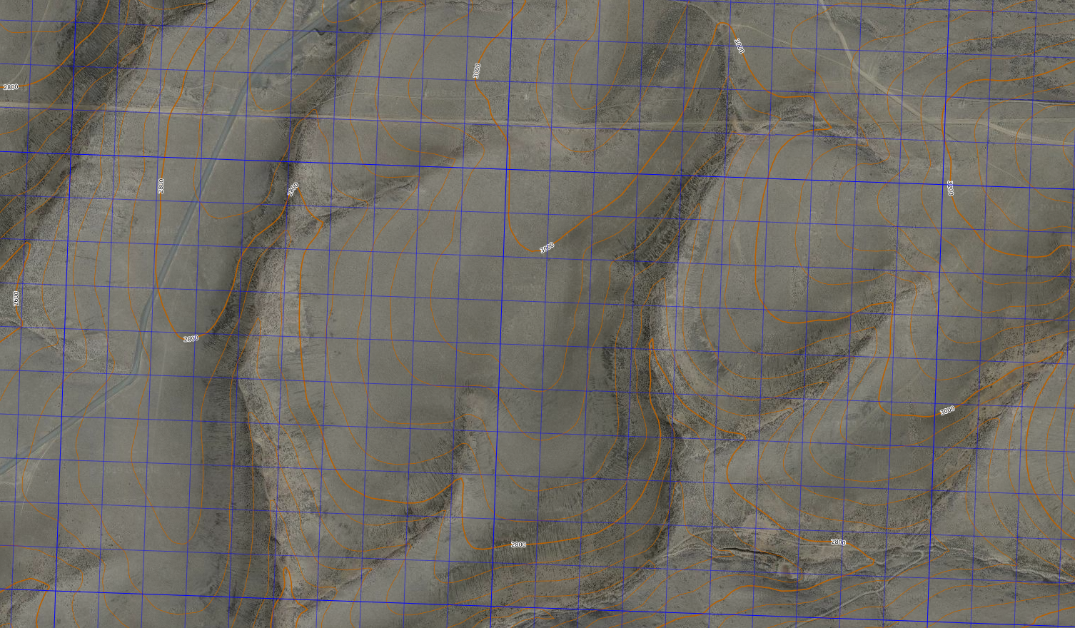

Slide 14
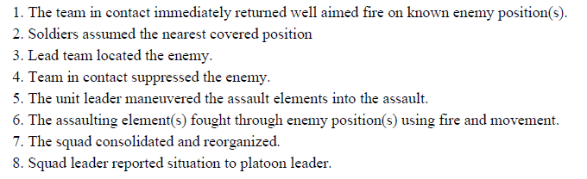
Task Measures as per 07-4-D9515

